Slide 1
TERMS AND CONDITIONS
These PowerPoint slides are a tool for lecturers, and as such:
YOU MAY add content to the slides, delete content from the slides, print out the slides, and save the slides onto your computer or server.
YOU MAY NOT resell, reproduce or redistribute the content in any form whatsoever, without prior written permission from the copyright holder.
© Troupant Publishers (Pty) Ltd, 2016
Selected images used under licence from Shutterstock.com

Slide 2
Engineering Systems
NQF Level 2

Slide 3
Safety precautions for operating equipment with simple control systems
Module 12

Slide 4
Safety precautions for equipment with simple control systems
Unit 12 .1

Slide 5
Hazards
Defining hazards
A hazard is any source of or exposure to danger, such as electric shock, heat or noise.

Slide 6
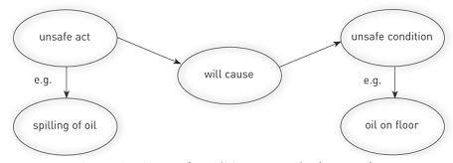
Hazards
Defining hazards
Figure 12.4 An unsafe condition as a result of an unsafe act

Slide 7
Types of hazards
The five main types of hazards:
Chemical.
Electrical.
Physical.
Psychosocial.
Ergonomic.

Slide 8
How to deal with hazards
Table 12.1 Some common hazards, effects and preventative actions

Slide 9
How to deal with hazards
Table 12.1 Some common hazards, effects and preventative actions (continued)

Slide 10
General basic safety rules
Wear safety glasses at all times in work areas.
Contain long hair.
Wear appropriate footwear with substantial uppers.
Wear close-fitting or protective clothing.
Do not wear rings and other jewellery.

Slide 11
General basic safety rules
Ensure all flammable materials are safely stored.
Follow all safety signs and instructions.
Do not play around in a workshop.
Be careful and cautious about your surroundings.
Inspect hand and power tools before using them.

Slide 12
VIDEO: Safe working conditions

Slide 13
Avoiding injury when using machinery
Two main ways of avoiding injury:
Keep people away from danger area while the machine is in operation.
Prevent the machine parts from moving when people are in the danger area.

Slide 14
Avoiding injury when using machinery
Two-hand controls.
Emergency switches.
Emergency stop or E-stop buttons.

Slide 15
Pneumatic safety
General pneumatic safety guidelines
Take care when removing and reconnecting air lines.
Remove all plastic and other types of port dust caps, fitted for transportation purposes, before connecting the units to the air supply.
Ensure that all air connections are mechanically tight.

Slide 16
General pneumatic safety guidelines
Check that all cylinder tie rods and mountings are firmly fixed.
Ensure that end cover screws, valve mechanisms and piston rod nuts are fully tightened before pressure is applied to any component.
Take great care when connecting electrical wiring to solenoid valves and pressure switches that the equipment is property installed.
Make sure that all electrical devices are suitably fused, insulated and earthed.

Slide 17
General pneumatic safety guidelines
When checking the installation, make sure that this is done under fully safe conditions.
If checking cylinder movements for mechanical alignment, whether under pressure or not, make sure that hands, fingers or other parts of the body cannot be trapped.
If the machine design allows it, pressure should first be introduced slowly into the system.

Slide 18
Hydraulic safety
Three kinds of hazards:
Burns from hot, high-pressure fluid.
Bruises, cuts or abrasions from flailing hydraulic lines.
The injection of fluid into the skin.

Slide 19
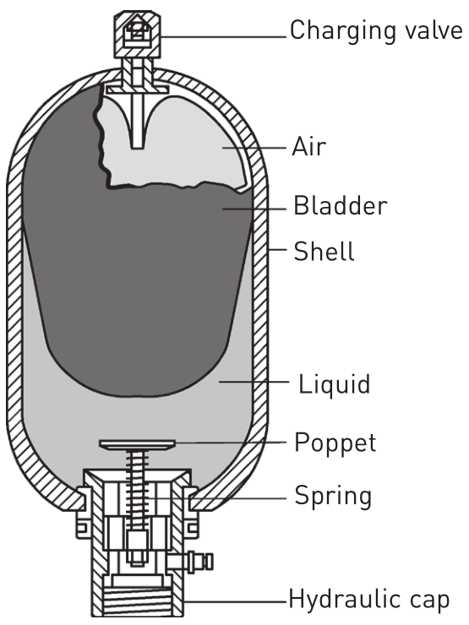
Hydraulic safety
Figure 12.14 An accumulator

Slide 20
Pinhole leak injuries
Figure 12.15 Methods used to detect leaks

Slide 21
General hydraulic safety guidelines
Never service the hydraulic system while the machine engine is running.
Block up the working units when you have to work on the system while it is raised.
Do not remove cylinders until the working units are resting on the ground or are secure on safety stands or blocks.
When transporting the machine, lock the cylinder stops to hold the working units solidly in place.

Slide 22
General hydraulic safety guidelines
Before disconnecting oil lines, relieve all hydraulic pressure and discharge the accumulator.
Ensure that all line connections are tight and lines are not damaged.
Some hydraulic pumps and control valves are heavy. Before removing them, provide a means of support such as a chain hoist, floor jack or blocks.
When washing parts, use a non-volatile cleaning solvent.

Slide 23
Checking hydraulic and pneumatic hoses
Hoses that rub against each other or against other parts cause abrasion, leading to hose failure.
The hose maximum working pressure rating must be higher than the system maximum pressure rating.
Hose assemblies must be correctly manufactured.
Ensure that the hose bend radius is not too tight.
Avoid bending hoses at fittings.
Do not twist hoses.

Slide 24
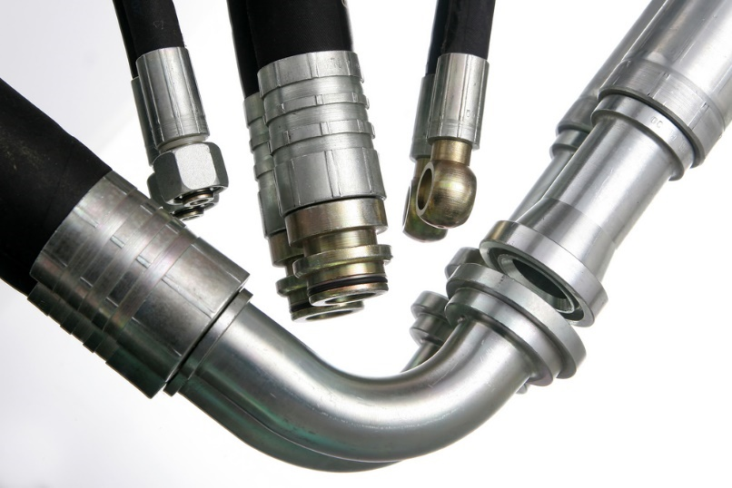
Checking hydraulic and pneumatic hoses
Figure 12.16 Different hose fittings

Slide 25
Fail-safe PLC installation
Installation compliance
Figure 12.17 Cabling for a PLC

Slide 26
Safety measures for portable electric drilling machines
Always be sure that you have a firm footing.
Ensure that no one is below you when using the power tool in a high location.
Do not replace a drill bit until the machine has been switched off, the plug has been removed and the chuck stops rotating completely.

Slide 27
Safety measures for portable electric drilling machines
Do not use your hand as a brake to slow the chuck down.
Use the key to tighten the chuck. Do not use your hand to tighten it. (This does not apply to keyless chucks.)
You will damage the motor and gearbox mechanism if you use incorrect drill bits and attachments.
Worn, damaged, twisted or blunt drill bits will result in poor cutting performance – do not use them.

Slide 28
Safety measures for portable electric drilling machines
When drilling larger holes, first drill a pilot hole of small diameter.
While you are drilling, ensure that nothing will get in the way such as rotating parts of machines, clothing, etc.
Avoid using the trigger lock switch.
Do not touch the drill bit or the workpiece immediately after use – they may be hot!

Slide 29
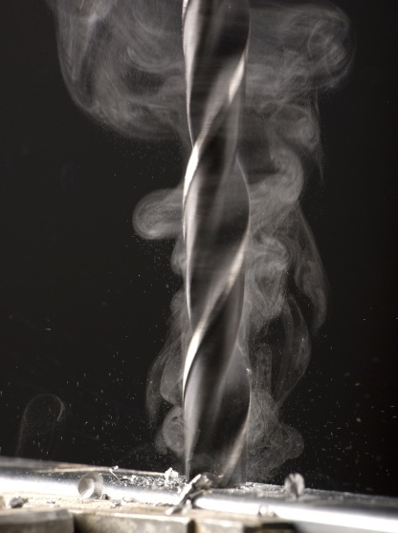
Safety measures for portable electric drilling machines
Figure 12.18 A drill bit is hot after drilling

Slide 30
Safety measures for drill presses
Fasten a drill press securely to a stand or workbench fastened to the floor.
Adjust the table or depth stop to avoid drilling into the table.
Do not turn the tool on before clearing the table of all objects such as tools.
Never start the drill press with the drill bit or cutting tool in contact with the workpiece.

Slide 31
Safety measures for drill presses
Always keep your hands and fingers away from the drill bit or cutting tool.
Do not attempt to drill material that does not have a flat surface unless a suitable support is used.
Avoid awkward hand positions.
Always use a vice or clamps.
Do not knock the drill bit with a hammer.

Slide 32
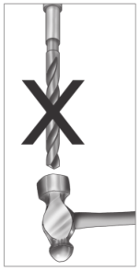
Safety measures for drill presses
Figure 12.19 Do not knock the drill bit with a hammer

Slide 33
Safety measures for drill presses
Use the recommended speed for the drill, accessory or workpiece material.
Ensure all lock handles are tightened before starting the machine.
Always use a wooden block when removing drill bits.

Slide 34
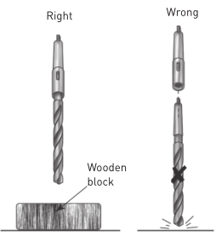
Safety measures for drill presses
Figure 12.20 Always use a wooden block when removing drill bits

Slide 35
Safety measures for bench grinders
Handle and store wheels in a careful manner.
Use safety goggles at all times.
Visually inspect all wheels for possible damage before mounting.
Check the machine speed against the safe operating speed marked on the wheel.

Slide 36
Safety measures for bench grinders
Check the mounting flanges for equal and correct diameter.
Do not use mounting flanges with surfaces that are not clean, flat and free of burrs.
Do not tighten the mounting nut excessively.

Slide 37
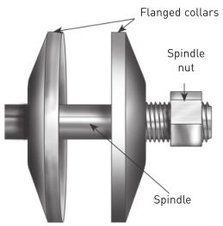
Safety measures for bench grinders
Figure 12.1 Mounting flanges

Slide 38
Safety measures for bench grinders
Use wheel mounting spacers.
Make sure the tool rest is 2 mm away from the wheel.
Use a safety guard covering at least one half of the grinding wheel.

Slide 39
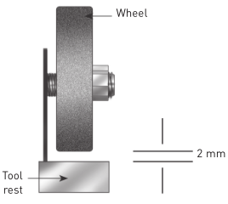
Safety measures for bench grinders
Figure 12.22 Distance between tool rest and wheel

Slide 40
Safety measures for bench grinders
Do not start the grinder until the wheel guard is in place.
Allow newly mounted wheels to run at operating speed with the safety guard in place for at least one minute.
Do not stand directly in front of a grinding wheel when you start it.
Do not force a wheel onto the grinder or change the size of the mounting hole.

Slide 41
Safety measures for bench grinders
Do not grind on the side or edge of the wheel.
Do not force grinding so that the motor slows or the workpiece gets very hot.
Do not use a wheel beyond its capacity.
Do not adjust the tool rest while the wheel is in motion.

Slide 42
Safety measures for angle grinders
Keep a firm footing and balance at all times.
Use clamps or vices to hold the workpiece.
Make sure that the wheel is not in contact with the workpiece before you turn the machine on.
Do not force the grinder.
Do not force small tool attachments to do the job of a heavy-duty grinder.

Slide 43
Safety measures for angle grinders
Figure 12.24 Do not hold the workpiece in your hands

Slide 44
Safety measures for angle grinders
Make sure that you have the correct size of disc, that it is compatible with the grinder and that the disc fits the spindle.
Check the disc before use.
Be careful not to damage the spindle, the flange or the locknut.
Watch what you are doing and use common sense.
Do not rush to complete the job.

Slide 45
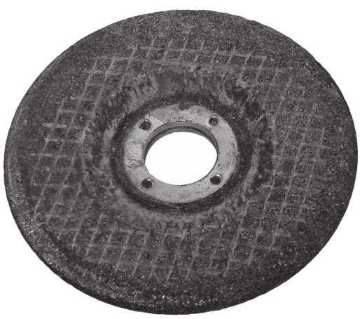
Safety measures for angle grinders
Figure 12.25 A worn-out disc

Slide 46
Safety measures for angle grinders
Always hold the tool so that sparks fly away from you.
Check that the speed marked on the grinding wheel is equal to or greater than the rated speed of the grinder.
Never use the grinder if the wheel guard has been removed.

Slide 47
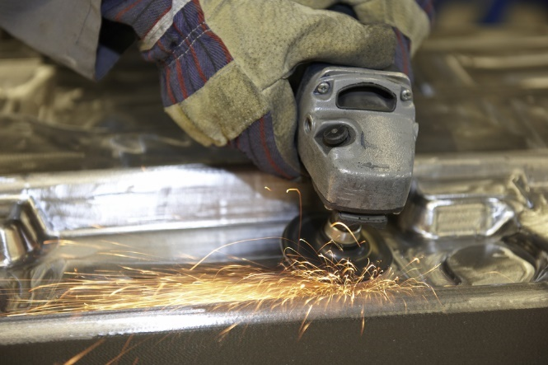
Safety measures for angle grinders
Figure 12.26 Always hold the tool so that sparks fly away from you
Figure 12.27 Never use the grinder if the wheel guard has been removed

Slide 48
Safety measures for air compressors
Ensure no slip or trip hazards are present in workspaces and walkways.
Locate the compressor in a suitable place for safe operation.
Lock the wheels on the base of the compressor to prevent movement.
Check that all fittings and connections are securely connected before pressurising the system.

Slide 49
Safety measures for air compressors
Figure 12.28 Check all hose connections and fittings before pressurising the system

Slide 50
Safety measures for air compressors
Check the condition of the belts for signs of wear.
Check that the guards are securely and correctly mounted.
Locate and ensure that you are familiar with the operation of the on/off button.
Make sure there is sufficient space around the compressor for easy movement and emergency evacuation.

Slide 51
Safety measures for air compressors
Start the compressor, noting the increase in pressure and cut-out.
Listen for air leaks from the air lines and immediately report any leaks you observe.
Adjust the pressure regulator to suit the work requirements.
Check the compressor at regular intervals while working.

Slide 52
Using manufacturers’ manuals to aid safety
Manuals should provide the following:
A description of the equipment.
The specifications.
The dimensions.
Installation instructions.
Setting-up instructions and procedures.
Warranties.
Applications.
Diagrams and circuit layouts, where appropriate.
Component data sheets.

Slide 53
Implications of non-conformance with the manufacturer’s specifications when operating equipment with simple control systems
Severe bodily injury or loss of life.
Damage to or failure of the equipment.
Voiding of the warranty of the equipment.
Loss of production.

Slide 54
Summative assessment
Test your knowledge of this section by completing the Summative assessment (page 206 of your Student’s Book)

